Slide 1
DOMINICAN INSTITUTE FOR QUALITY
INDOCAL
Time and Frequency

Slide 2
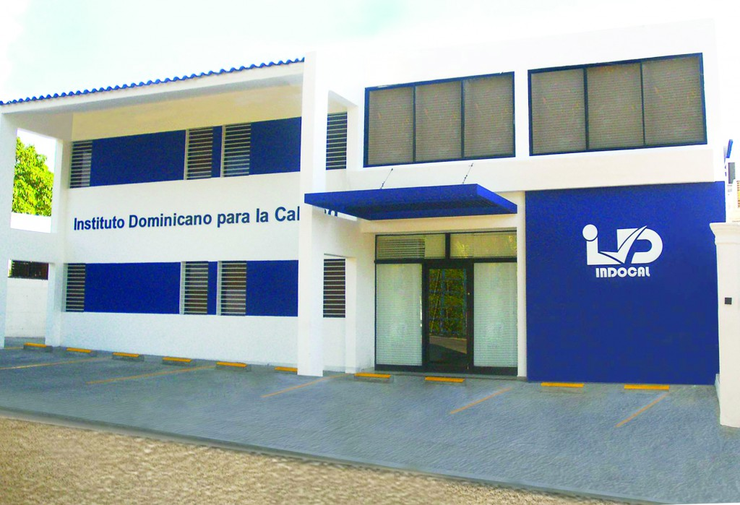
INDOCAL

Slide 3
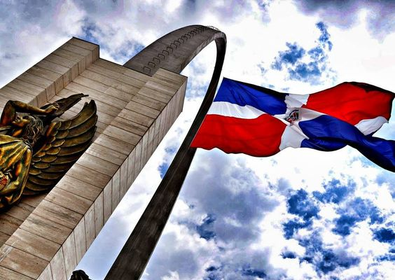

Slide 4
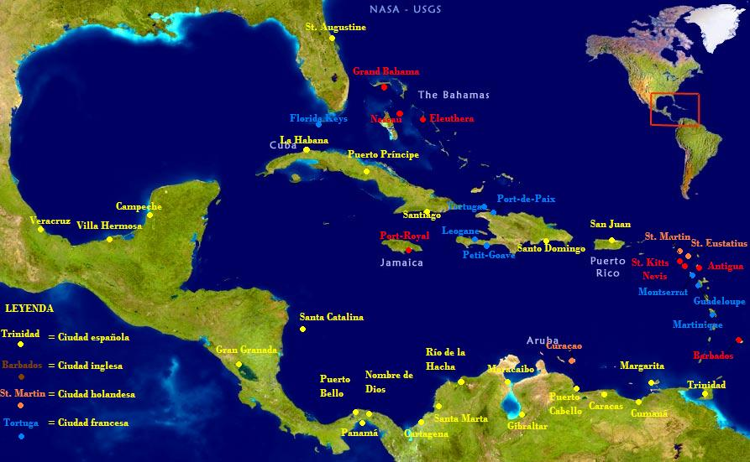
INDOCAL

Slide 5
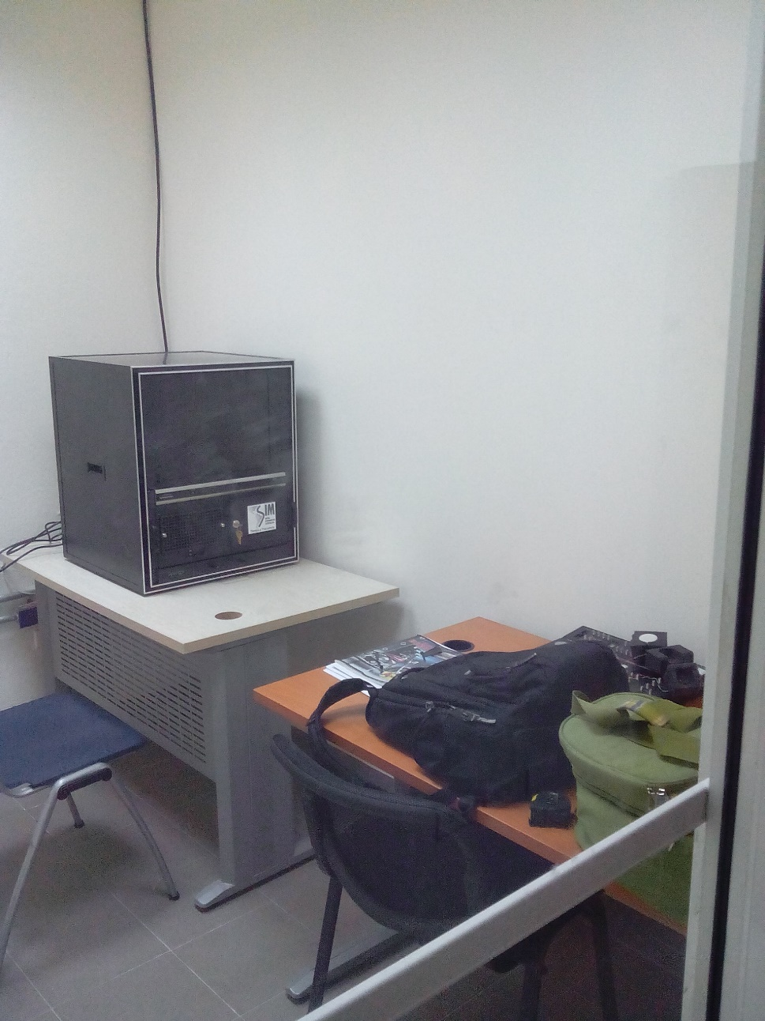
2015 JULY

Slide 6
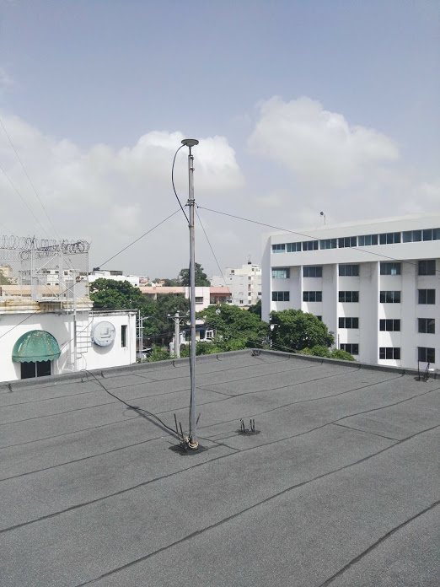
GPS ANTENNA

Slide 7
Dissemination
Dissemination of time via web
Dissemination of time via internet
Services
Stopwatch calibration (working on that)

Slide 8
Web Clock

Slide 9
MEINBERG LANTIME M600
Domain
HORADOMINICANA.INDOCAL.GOB.DO

Slide 10
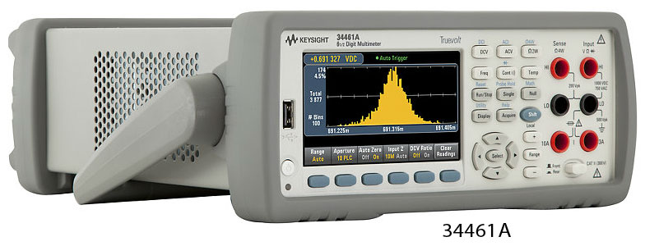
KEYSIGHT 34461A

Slide 11
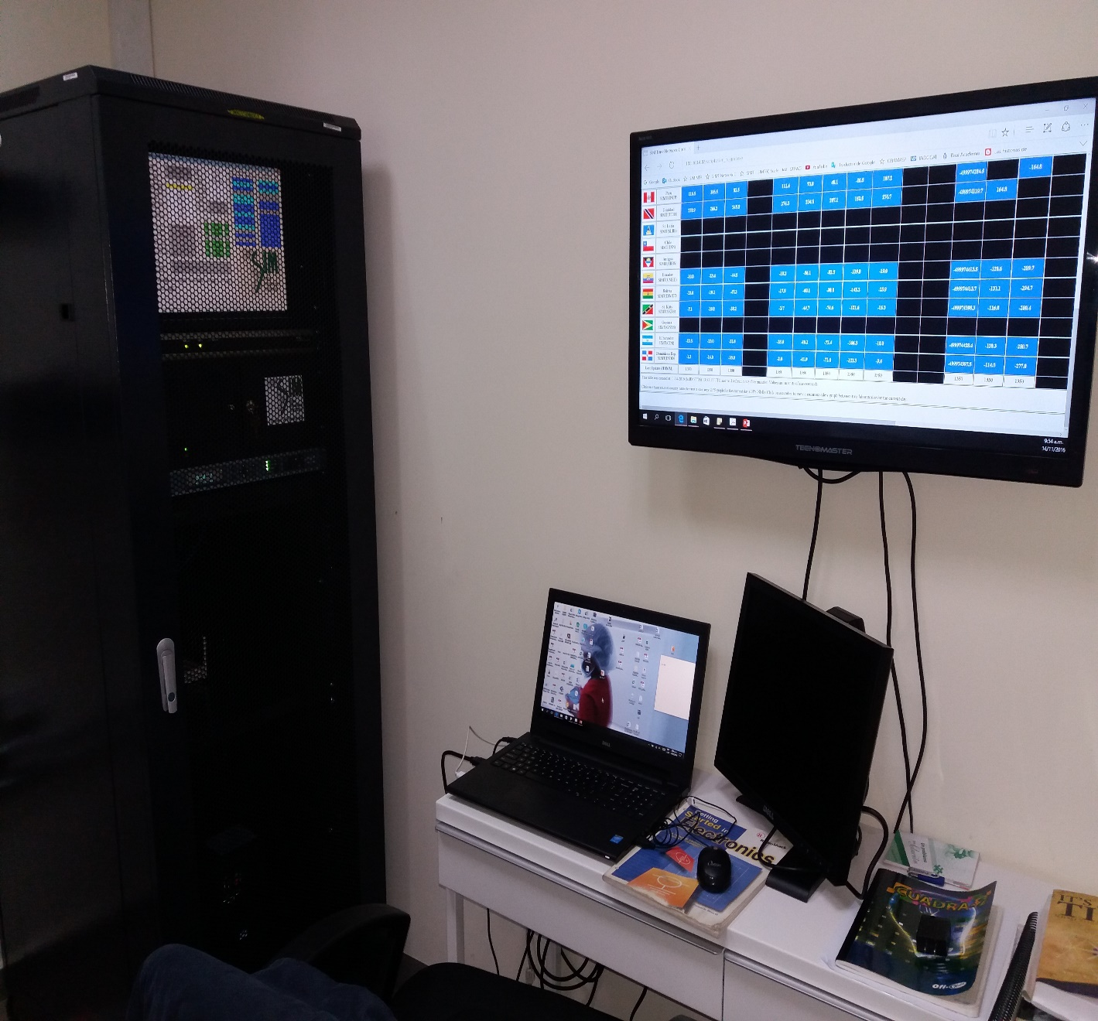
Equipments
NTP server
New Rack
Laptop pc

Slide 12
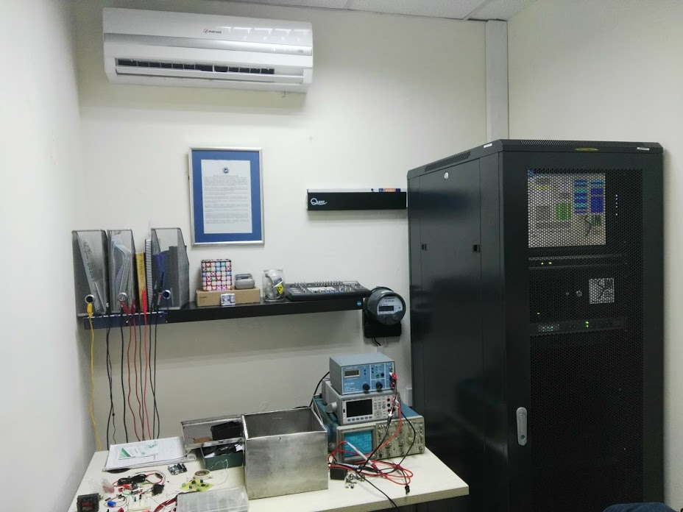

Slide 13
Stopwatch calibrator

Slide 14
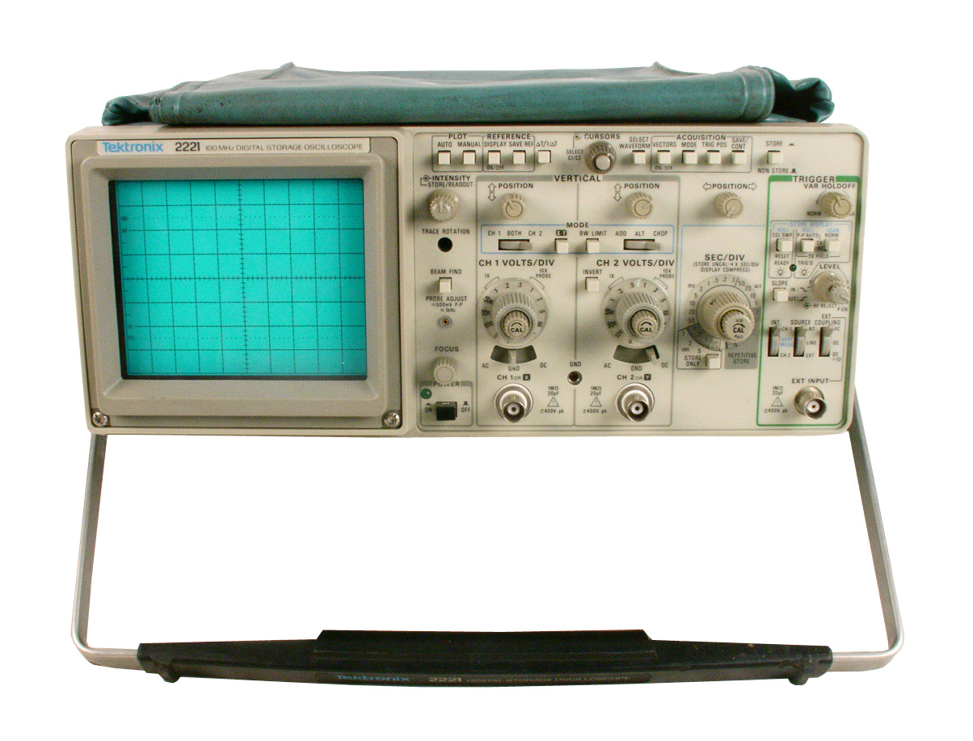

Slide 15
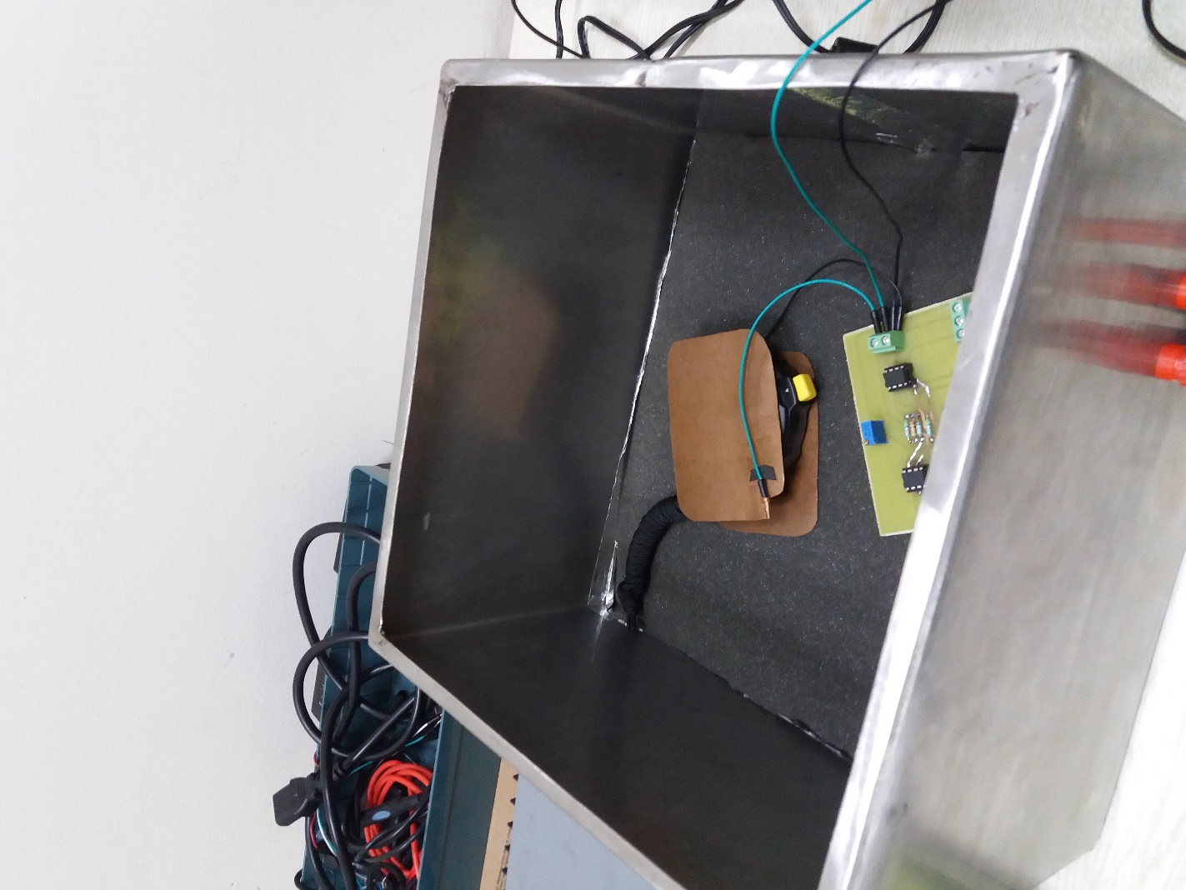
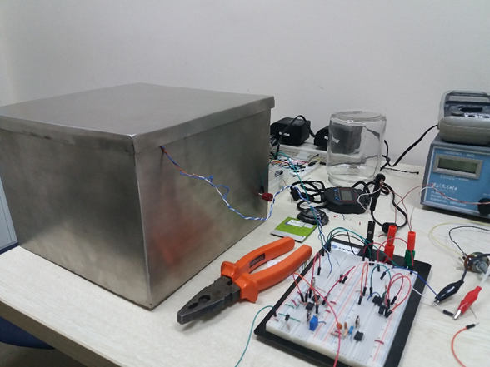
Digital Stopwatch Calibration

Slide 16
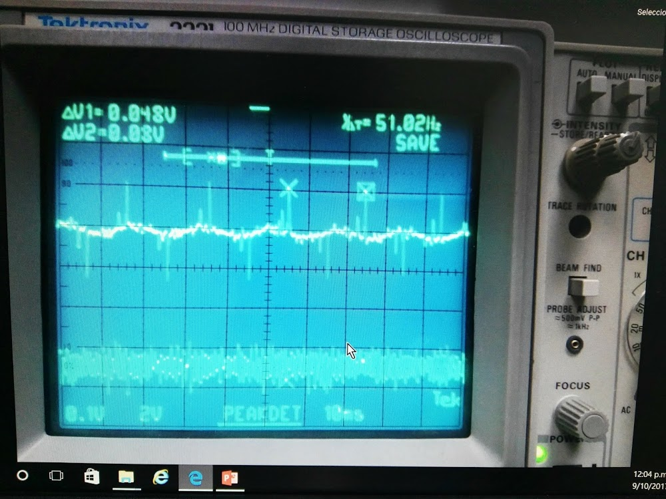
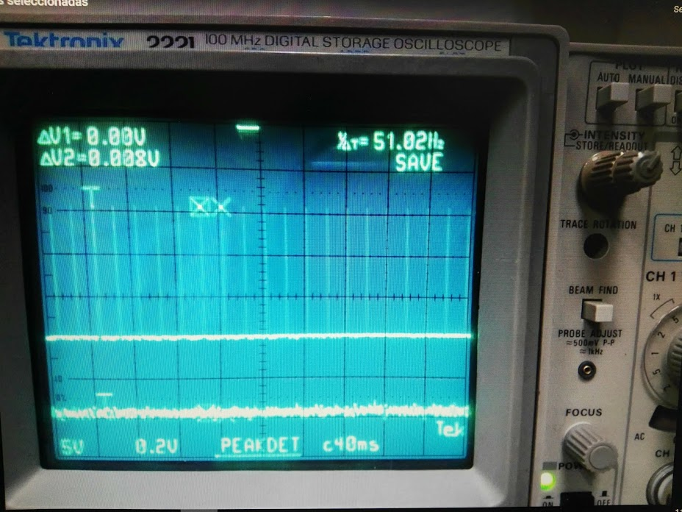
Signal in the input
Output of the circuit
Output signal after a voltage comparator filter

Slide 17
Another Base time Calibrator

Slide 18
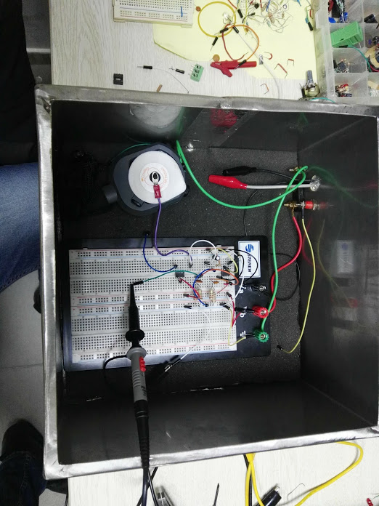

Slide 19
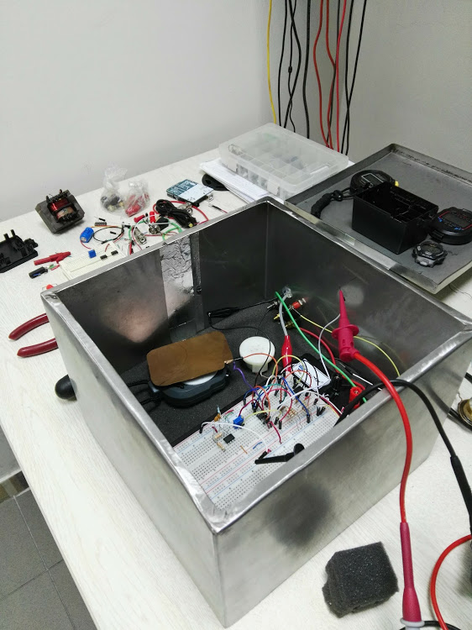

Slide 20
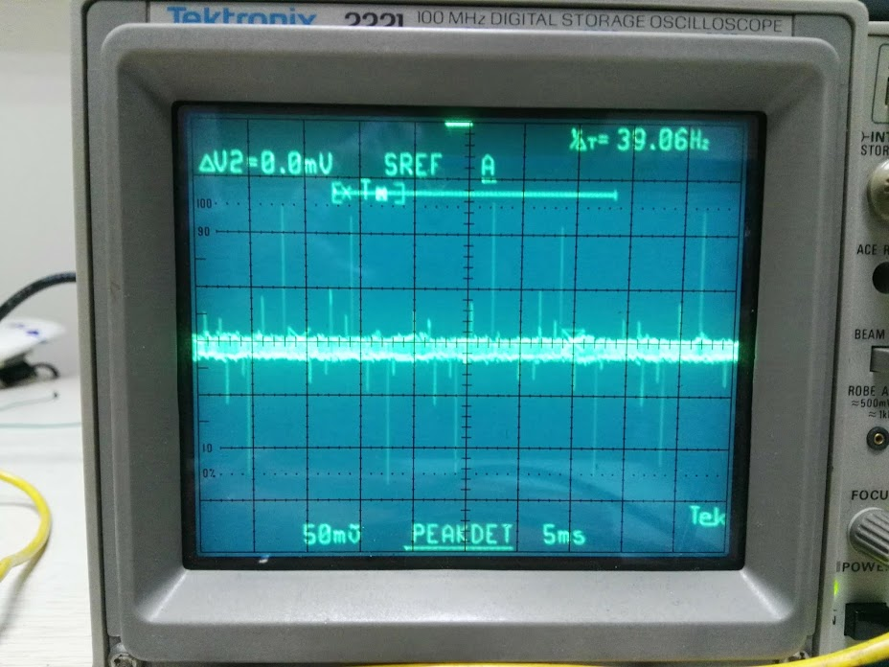
Using LabView

Slide 21
Adquisition and Processing data using LabView

Slide 23
Getting and Processing Data Using Python 3

Slide 26
Goals
Digital Stopwhatch calibration
Tachometer calibration
Get a Universal Counter
Get a Funtion Generator

Slide 27
Especial thanks to
Ruben Neris (In charge of the laboratories)
Haygas Kalustian (Consultor)
Raul Solís (Web clock code and advices)
Michael Lombardi (Web clock code, Sim time system support and advices)
Oscar Fallas (Help with the time base calibrator and uncertainty budget)
Liz Catherine (For her help, is an extraordinary person)

Slide 28
Omar Reyes omarrey17@hotmail.com
Thank you

